Slide 1
TI-Nspire Graphing Calculators

Slide 2
Hands-on Activities

Slide 3
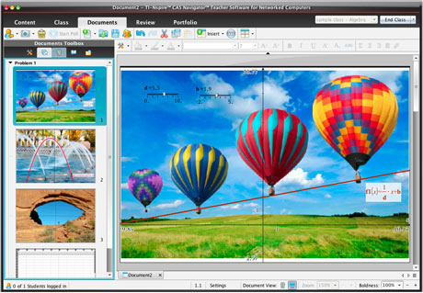
Real-World Applications

Slide 4
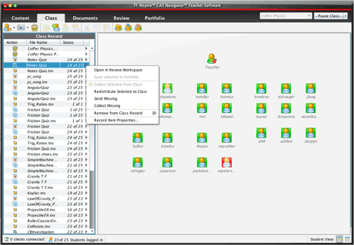
Make ALL Students Accountable

Slide 5
Instruction Driven by Formative Assessment

Slide 6
Investigating Equivalent Solutions

Slide 7
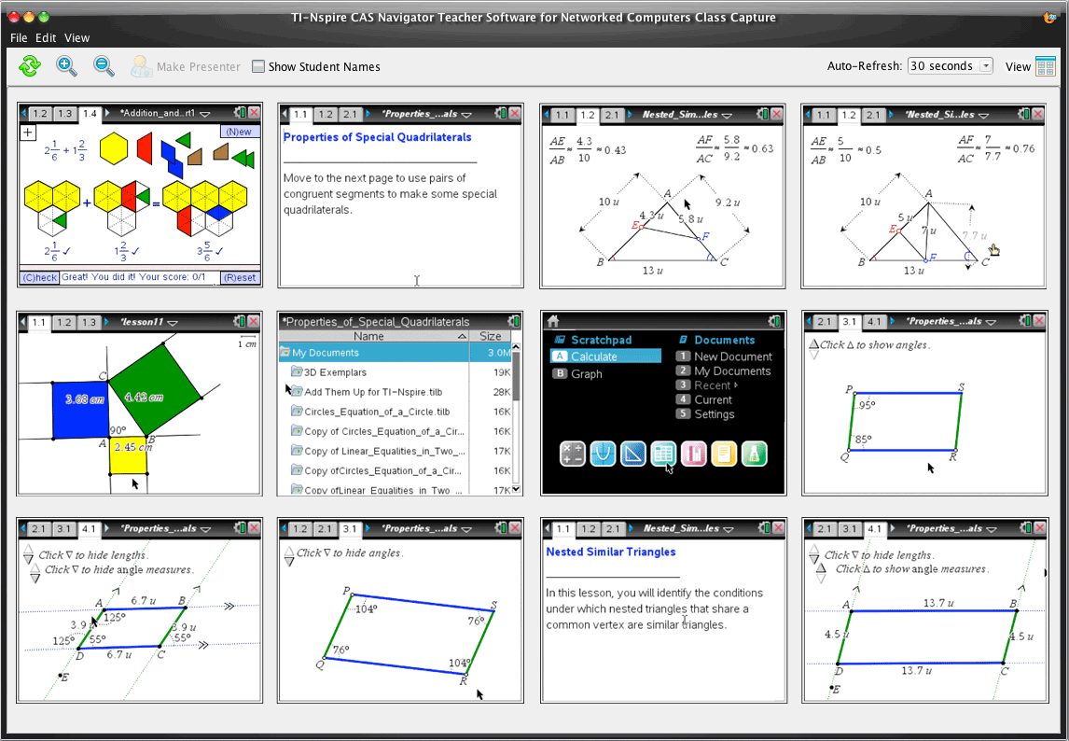
Allow Students to Learn at Different Speeds

Slide 8
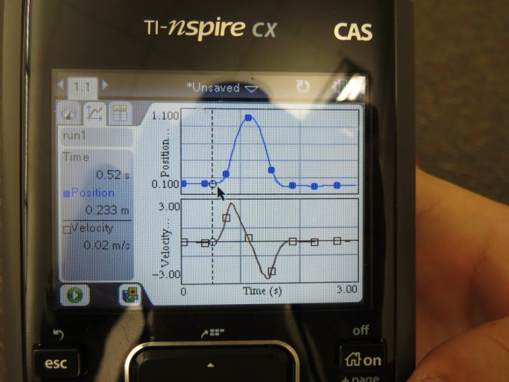
Motion Graphing Vertical Ball Toss

Slide 9
Motion Graphing Position, Velocity and Acceleration

Slide 10
Live Feedback

Slide 11
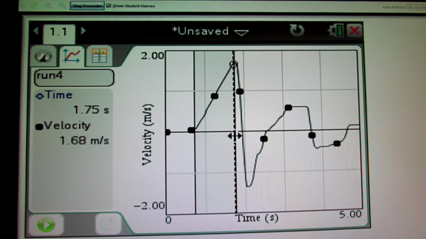
Motion Graphing Acceleration
Analyzing Graph Slopes

Slide 12
Calculating Impact Force using Energy and Impulse

